Slide 1
Using Terraform to Drive Security Automation in AWS Continuous Monitoring

Slide 2
By the end of this talk, you will (hopefully) learn how to:
Monitor CloudTrail for events you might care about
Route GuardDuty alerts into Slack
Use AWS SecurityHub to monitor compliance
Use AWS Config to enforce policies
Use CloudWatch Logs to detect issues in your apps
Notes:
A lot of people are interested in security automation, and there are hundreds of talks available online. For some reason, most of them focus on automated remediation, which few of us are actually going to take the time to implement. This talk will give you strategies that you can immediately deploy to start gaining visibility into your infrastructure and applications.

Slide 3
By the end of this talk, you will (hopefully) learn how to:
Monitor CloudTrail for events you might care about
Route GuardDuty alerts into Slack
Use AWS SecurityHub to monitor compliance
Use AWS Config to enforce policies
Use CloudWatch Logs to detect issues in your apps
You will not learn how to:
Build a Lambda that automatically remediates issues
Notes:
Automated remediations are nifty, but building automated remediations before you’ve built a strong automated detection game is kind of like building the deck before you’ve built the house.

Slide 4

Terraform In A Nutshell
https://github.com/rhythmictech/sample-aws-project
Notes:
Terraform is made by Hashicorp and is open source.
Declarative, like many configuration management frameworks.
Describe your state in HCL. Let Terraform generate a plan. Apply it if it looks good.

Slide 5
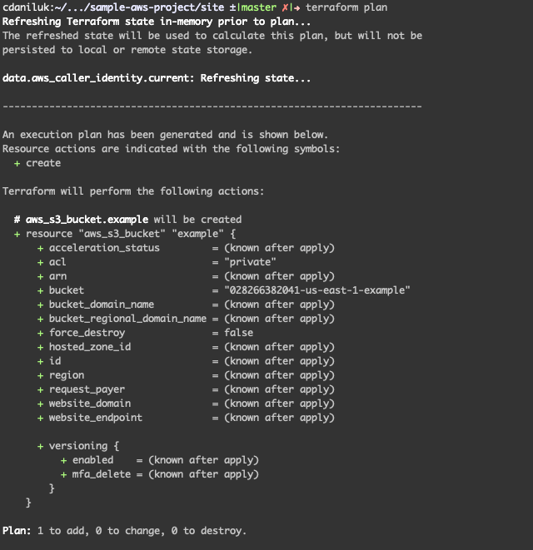
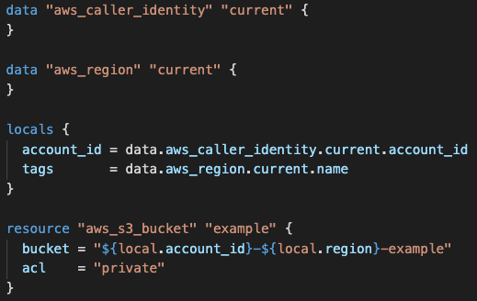
Terraform Plan
Notes:
Terraform takes a declarative configuration and trues up the target. Plans are used so that admins can validate the changes are correct.
Plans can be saved and run later. This allows for CICD style workflows, including tools like Atlantis that can automatically apply approved/tested changes.

Slide 6
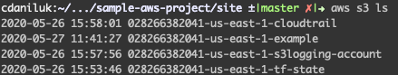
Terraform Apply
Notes:
Once a plan is applied, the changes are immediately visible in the AWS CLI.

Slide 7
Terraform Strengths:
Manages evolving infrastructure very well
Enables CICD-like workflows to create, test and apply infrastructure changes
Can produce highly reusable code
Finds and corrects secret changes
Weaknesses:
Doesn’t always play nicely with other IaC tools
Lots of sharp edges for managing/deploying complex applications, particularly serverless

Slide 8
Succeeding With Terraform:
Leverage open source modules
Use multiple AWS accounts tied to branches whenever possible
Write your own modules (and version them!)
Use separate IaC for application deployments (e.g., Serverless, CloudFormation, CDK)
Use separate IaC for image building (Terraform, EC2 Image Builder and Ansible are a powerful combination)
Build clean boundaries between IaC systems. Rely on bridges like SSM to avoid hardcoding.
Branch out and use other providers. Use TF to manage PagerDuty, GitHub, CloudFlare, etc.
To get the most value out of Terraform, focus on writing reusable code and firmly defining the strategy for how all of your IaC tools will integrate together to provide a complete solution.

Slide 9
Monitoring CloudTrail Activity
https://github.com/rhythmictech/terraform-aws-cloudtrail-logging
Notes:
Demonstrates detecting and alerting on unexpected permission changes.

Slide 10
Routing GuardDuty Findings
https://github.com/rhythmictech/terraform-aws-guardduty-to-sns
Notes:
Uses guardduty tester to generate alerts and route them through to PagerDuty.

Slide 11
Routing AWS Config Notifications
https://github.com/rhythmictech/terraform-aws-config
Notes:
Sets up AWS Config with Recorder and configures rules notifications to Jira. However, for demo purposes, no rules are actually configured.

Slide 12
Monitoring Application Activity
https://github.com/cdaniluk/sample-aws-project
Notes:
Demonstrates using CloudWatch Logs and Metric Filters to alert based on application logs.

Slide 13
Routing Security Hub Findings
https://github.com/rhythmictech/terraform-aws-securityhub-to-sns
Notes:
Demonstrates in a noisy way how to tie SecurityHub into Slack (not recommended for real-world use).

Slide 14
Routing Security Hub Findings
Warning: SecurityHub is noisy. You will want to filter the event stream.
You can write a simple Lambda or use something more powerful (we use StreamAlert).
https://github.com/rhythmictech/terraform-aws-securityhub-to-sns

Slide 15
Before you turn these things all on..
Security Hub does not play nicely with other integrations. If you aren’t going to route everything through it and make it a real hub, don’t configure notifications for it.
AWS Config has tons of rules you can turn on by default. Turn on only what you can take action on.
Think about who will be responsible for being on the receiving end of every automation you make.
Start small.
Getting Started Checklist
CloudTrail will collect data that can help you investigate in the future.
Set an IAM Password Policy, stop using the root account and rotate your keys (or use SSO!)
Implement the CIS benchmarks. Our Terraform modules automate CIS compliance, and Security Hub will validate your progress.

Slide 16
Useful Resources
Terraform – https://www.terraform.io/
Terraform Registry - https://registry.terraform.io/
Our GitHub - https://github.com/rhythmictech/
Our Blog - https://www.rhythmictech.com/blog/
StreamAlert - https://www.streamalert.io/
Prowler - https://github.com/toniblyx/prowler
GuardDuty Tester - https://github.com/awslabs/amazon-guardduty-tester
Notes:
Terraform – the documentation is often more useful than AWS
Terraform Registry – home to thousands of modules and providers
Rhythmic’s GitHub – hundreds of OSS / TF modules
Rhythmic’s blog – musings on AWS, K8s, Terraform
StreamAlert – a powerful, simple tool to route and squelch alerts
Prowler – additional checks beyond what SecurityHub offers
GuardDuty Tester – slightly more realistic testing than “Generate Sample Findings”. Easy to stand up and tear down.

Slide 17
Thank You
Stay Connected
@RhythmicTech
Rhythmic Technologies, Inc.
info@rhythmictech.com
RhythmicTech
Rhythmic helps companies increase their DevOps, security and cost maturity in AWS.
Over 100 OSS Terraform and Ansible modules
We run Kubernetes in production
We believe automation is the foundation of ops in the cloud.
Sign up for our newsletter to learn more.

